Slide 1

Bus & Naming Scheme
Computer System Engineering, Fall 2018. (IPADS, SJTU)
Physical address space
Yubin Xia

Slide 2
Review: Layers

Slide 3
Review: A Canonical Device
Registers
Status
Address
Data
Command
Interface
Micro-controller (CPU)
Memory (DRAM or SRAM or both)
Other Hardware-specific Chips
Internals

Slide 4
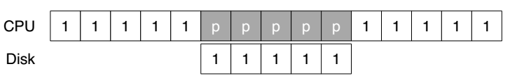
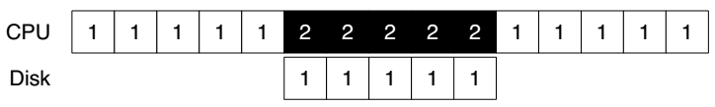
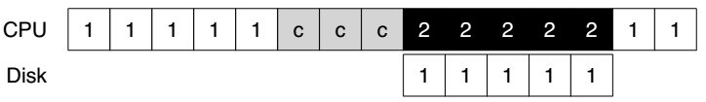
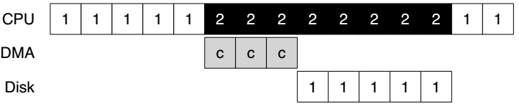
Review: Interrupt & DMA
Using Polling
Using Interrupt
Without DMA
With DMA

Slide 5
Review: Methods of Device Interaction
Method-1: PIO through I/O instructions
On x86, in and out instructions
I/O port name space
Must be executed in privileged mode (kernel mode)
Method-2: Memory-mapped I/O
Using LOAD and STORE
Physical address space
Can also be executed in unprivileged mode (user mode)

Slide 6
Case Study: IDE Disk Driver

Slide 7
IDE Protocol
Address 0x1F0 = Data Port
Address 0x1F1 = Error
Address 0x1F2 = Sector Count
Address 0x1F3 = LBA low byte
Address 0x1F4 = LBA mid byte
Address 0x1F5 = LBA hi byte
Address 0x1F6 = 1B1D TOP4LBA: B=LBA, D=drive
Address 0x1F7 = Command/status
Wait for drive to be ready (0x1F7)
Read Status Register until drive is READY and not BUSY
Write parameters to command registers (0x1F2 – 0x1F6)
Sector count
Logical block address (LBA) of the sectors to be accessed
Drive number
Master=0x00 or slave=0x10, as IDE permits just two drives
Start the I/O (0x1F7)
By issuing read/write to command register
Write READ / WRITE command to command register

Slide 8
IDE Protocol
Address 0x1F0 = Data Port
Address 0x1F1 = Error
Address 0x1F2 = Sector Count
Address 0x1F3 = LBA low byte
Address 0x1F4 = LBA mid byte
Address 0x1F5 = LBA hi byte
Address 0x1F6 = 1B1D TOP4LBA: B=LBA, D=drive
Address 0x1F7 = Command/status
Data transfer (for writes)
Wait until drive status is READY and DRQ (drive request for data)
Write data to data port
Handle interrupts
In the simplest case, handle an interrupt for each sector transferred
More complex approaches allow batching and thus one final interrupt when the entire transfer is complete
Error handling
After each operation, read the status register
If the ERROR bit is on, read the error register for details

Slide 9
IDE Disk Driver using PIO
Address 0x1F0 = Data Port
Address 0x1F1 = Error
Address 0x1F2 = Sector Count
Address 0x1F3 = LBA low byte
Address 0x1F4 = LBA mid byte
Address 0x1F5 = LBA hi byte
Address 0x1F6 = 1B1D TOP4LBA: B=LBA, D=drive
Address 0x1F7 = Command/status
static int ide_wait_ready() {
while (((int r = inb(0x1f7)) & IDE_BSY) || !(r & IDE_DRDY))
; // loop until drive isn’t busy
}
static void ide_start_request(struct buf *b) {
ide_wait_ready();
outb(0x3f6, 0); // generate interrupt
outb(0x1f2, 1); // how many sectors?
outb(0x1f3, b->sector & 0xff); // Block address here ...
outb(0x1f4, (b->sector >> 8) & 0xff); // ... and here
outb(0x1f5, (b->sector >> 16) & 0xff); // ... and here!
outb(0x1f6, 0xe0 | ((b->dev&1)<<4) | ((b->sector>>24)&0x0f));
if(b->flags & B_DIRTY){
outb(0x1f7, IDE_CMD_WRITE); // this is a WRITE
outsl(0x1f0, b->data, 512/4); // transfer data too!
} else {
outb(0x1f7, IDE_CMD_READ); // this is a READ (no data)
}
}
Status
Register
(0x1F7):
7: BUSY
6: READY
5: FAULT
4: SEEK
3: DRQ
2: CORR
1: IDDEX
0: ERROR
Error
Register
(0x1F1):
7: BBK
6: UNC
5: MC
4: IDNF
3: MCR
2: ABRT
1: T0NF
0: AMNF
BBK = Bad Block
UNC = Uncorrectable data error
MC = Media Changed
IDNF = ID mark Not Found
MCR = Media Change Requested
ABRT = Command aborted
T0NF = Track 0 Not Found
AMNF = Address Mark Not Found

Slide 10
IDE Disk Driver using PIO
void ide_rw(struct buf *b) {
acquire(&ide_lock);
for (struct buf **pp = &ide_queue; *pp; pp=&(*pp)->qnext)
; // walk queue
*pp = b; // add request to end
if (ide_queue == b) // if q is empty
ide_start_request(b); // send req to disk
while ((b->flags & (B_VALID|B_DIRTY)) != B_VALID)
sleep(b, &ide_lock); // wait for completion
release(&ide_lock);
}

Slide 11
IDE Disk Driver using PIO
void ide_intr() {
struct buf *b;
acquire(&ide_lock);
if ((b = idequeue) == 0) {
release*&idelock); return;
}
idequeue = b-> next;
if (!(b->flags & B_DIRTY) && ide_wait_ready() >= 0)
insl(0x1f0, b->data, 512/4); // if READ: get data
b->flags |= B_VALID;
b->flags &= ~˜B_DIRTY;
wakeup(b); // wake waiting process
if (ide_queue != 0) // start next request
ide_start_request(ide_queue); // (if one exists)
release(&ide_lock);
}

Slide 12
Review: IDE Driver using PIO
Q: What is the process of disk write?
CPU waits for disk to be ready (ide_wait_ready)
CPU sends WRITE request to disk (which block to write? LBA)
CPU transfers data to the disk (outsl(0x1f0, b->data, 512/4))
CPU waits (CPU switches to another thread)
…
Disk finishes write (data maybe in disk’s buffer)
Disk sends an interrupt to CPU
CPU wakes up the waiting thread

Slide 13
Review: IDE Driver using PIO
Q: What is the process of disk read?
CPU waits for disk to be ready (ide_wait_ready)
CPU sends READ request to disk (which block to read? LBA)
CPU waits (CPU switches to another thread)
… (can be a long time)
Disk finishes read (data now in disk’s buffer)
Disk sends an interrupt to CPU
CPU reads data from disk’s buffer to memory (insl(0x1f0, b->data, 512/4))
CPU wakes up the waiting thread

Slide 14
BUS: a hardware layer

Slide 15
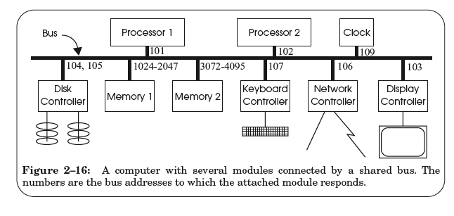
A Hardware Layer: the Bus

Slide 16
Bus Features
A set of wires
Comprising address, data, control lines that connect to a bus interface on each module
Broadcast link
Every module hears every message
Bus address: identify the intended recipient, as the name
Bus arbitration protocol
Decide which module may send or receive message at any particular time
Bus arbiter (optional): a circuit to choose which modules can use the bus

Slide 17
Bus Transaction
Source module requires exclusive use of the bus: the data sender
Source module places a bus address of the destine module on the bus
Source module signals READY wire to alert the other module
The destine module singles ACKNOWLEDGE wire after copied the data
If synchronized, then READY & ACKNOWLEDGE are not needed, just need to check the address lines on each clock cycle
Source module releases the bus

Slide 18
Memory Load Example: LOAD 1742, R1
Processor #2 => all bus modules: {1742, READ, 102}

Slide 19
Memory Load Example: LOAD 1742, R1
Memory 1 recognizes the address is within its range
By examining just a few high-order address bits

Slide 20
Memory Load Example: LOAD 1742, R1
Memory 1 acknowledges and processor 2 releases the bus
Memory 1 performs the internal operation to get the value
value <- READ (1742)

Slide 21
Memory Load Example: LOAD 1742, R1
Memory1 => all bus modules: {102, value}

Slide 22
Memory Load Example: LOAD 1742, R1
Processor 2 is waiting for this result, just copies the data on the bus to its register R1

Slide 23
Memory Load Example: LOAD 1742, R1
Processor 2 acknowledges and memory 1 releases the bus

Slide 24
Sync VS. Async
Sync data transfer
Source & destination cooperate through a shared clock
Async data transfer
Source and destination cooperate through explicit signal line
E.g., acknowledge line

Slide 25
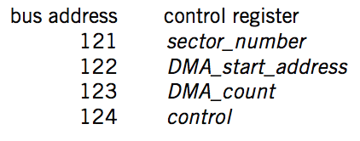
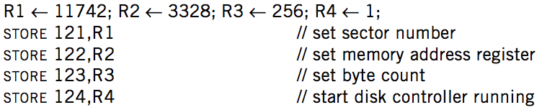

DMA on Bus

Slide 26
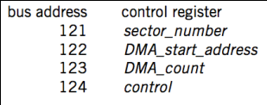
DMA Example
Processor 1
Processor 2
101
102
256-511
3072-4095
121-124
BIOS
Memory
Disk
Processor #1 => all bus modules: {121, WRITE, 11742}
Disk acknowledge and write the value 11742 to its control register
Processor #1 => all bus modules: {122, WRITE, 3328}
Processor #1 => all bus modules: {123, WRITE, 256}
Processor #1 => all bus modules: {124, WRITE, 1}

Slide 27
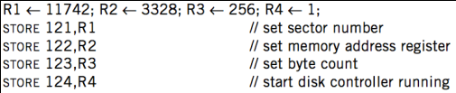
DMA Example
Processor 1
Processor 2
101
102
256-511
3072-4095
121-124
BIOS
Memory
Disk
Disk => all bus modules: {3328, WRITE, data[11742]}
Memory acknowledge and save data[11742]
Disk => all bus modules: {3329, WRITE, data[11743]}
... (loop)
Disk => all bus modules: {3583, WRITE, data[11997]}

Slide 28
DMA Example
Processor 1
Processor 2
101
102
256-511
3072-4095
121-124
BIOS
Memory
Disk
When transferring is finished, disk controller SENDs message to the processor
Just like keyboard controller does when press a key
Processor will enter interrupt handler next cycle
Now the processor knows that the DMA is done

Slide 29
Summary

Slide 30
Summary
CPU interacts with physical memory
Through system bus that connects each other
Using physical address to name memory content
CPU interacts with a device
Also using physical address (aka., bus address)
Polling, interrupt and DMA
I/O instruction (PIO) or MMIO

Slide 31
Summary
Memory Load/Store
Between CPU and memory
Physical memory address space
I/O Operations
MMIO: map device memory and registers into physical address space
DMA
Also using physical address
Processor
PIO (in/out)
/MMIO (load/store)
load/store
Memory
DMA
I/O Device

Slide 32
Questions
Q: How are the physical addresses assigned?
Memory physical addresses: by BIOS
Some devices (e.g., keyboard, IDE): fixed for all time
Other devices: assigned by the OS

Slide 33
Questions
Q: Why not map the whole disk to memory?
So that the CPU can access a byte on the disk directly by system bus
1. Too large
2. Too slow
The principle of least astonishment:
People are part of the system. The design should match the user’s experience, expectations, and mental models

Slide 34
Naming Scheme
Naming: the glue of modules

Slide 35
Naming in General
ipads.se.sjtu.edu.cn – hostname
steven@apple.com - email
steven – username
EAX - x86 processor register name
main() - function name
WebBrowser - class name
/courses/cse/index.html - path name (fully-qualified)
index.html - path name (relative)
http://ipads.se.sjtu.edu.cn/courses/cse/index.html - URL
13918275839- Phone number
202.120.40.188 - IP Address

Slide 36
Naming a Disk
File name: /dev/sda1
As a special type of inode: device inode
8,0 as (major, minor)
PCI address (name): 19:00.0
SCSI storage controller: LSI Logic / Symbios Logic SAS1068E PCI-Express Fusion-MPT SAS (rev 08)

Slide 37
Naming for Modularity
Retrieval: e.g., using URL to get a web page
Sharing: e.g., passing an object reference to a function
Save space as well: only sending the name, not the object
Hiding: e.g., using a file name without knowing file system
Can support access control: use an object only if knowing its name
E.g., Windows has many undocumented API
User-friendly identifiers: e.g., “homework.txt” instead of 0x051DE540
Indirection: e.g., OS can move the location of the file data without notifying the user
Have you ever defragmented your hard driver?

Slide 38
Addresses as Names
Software uses these names in an obvious way
E.g., memory addresses
Hardware modules connected to a bus
Use bus addresses (a kind of name) for interconnection

Slide 39
Naming Schemes
A naming schemes contains three parts:
1. Set of all possible names
You cannot use ‘for’ as a variable in C
2. Set of all possible values
3. Look-up algorithm to translate a name into a value
or a set of values, or “none”

Slide 40
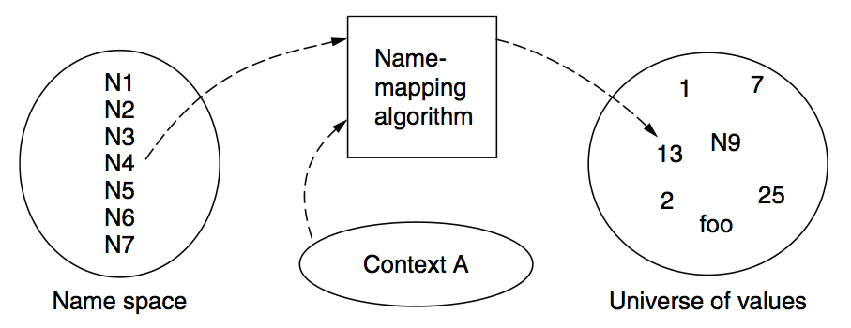
Naming Model

Slide 41
Naming Terminology
Binding – A mapping from a name to value
Unbind is to delete the mapping
A name that has a mapping is bound
A name mapping algorithm resolves a name

Slide 42
Naming Context
Type-1: context and name are separated
E.g., inode number’s context is the file system
Type-2: context is part of the name
E.g., xiayubin@sjtu.edu.cn
Name spaces with only one possible context are called universal name spaces
Example: credit card number, UUID, email address

Slide 43
Determining Context - 1
Hard code it in the resolver
Examples: Many universal name spaces work this way
Embedded in name itself
cse@sjtu.edu.cn:
Name = “cse”
Context = “sjtu.edu.cn”
/ipads.se.sjtu.edu.cn/courses/cse/README :
Name = “README”
Context = “/ipads.se.sjtu.edu.cn/courses/cse”

Slide 44
Determining Context - 2
Taken from environment (Dynamic)
Unix cmd: “rm foo”:
Name = “foo”, context is current dir
Question: how to find the binary of “rm” command?
Read memory 0x7c911109:
Name = “0x7c911109”,
Context is thread’s address space
Many errors in systems due to using wrong context

Slide 45
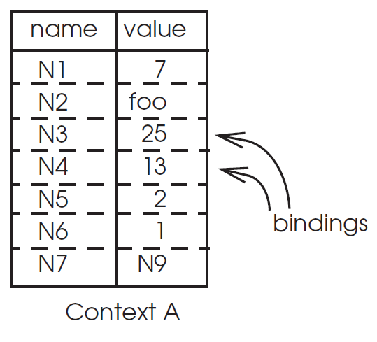
Name Mapping Algorithms - 1
Table lookup
Find name in a table
E.g., Phone book
Context: which table?
Implicit VS. explicit
Default context

Slide 46
Name Mapping Algorithms - 2
Recursive lookup
E.g., “/usr/bin/rm”
First find “usr” in “/”, then find “bin” in “/usr”, then “rm”
Each look-up process is the same
Multiple lookup
Recall: how to find “rm” without absolute name?
$PATH
E.g., “/usr/local/sbin:/usr/local/bin:/usr/sbin:/usr/bin:/sbin:/bin”
Look-up in a predefined list of context

Slide 47
Interpreter Naming API
value ← RESOLVE(name, context)
Return the mapping of name in the context
status ← BIND(name, value, context)
Establish a name to value mapping in the context
status ← UNBIND(name, context)
Delete name from context
list ← ENUMERATE(context)
Return a list of all bindings
result ← COMPARE(name1, name2)
Check if name1 and name2 are equal

Slide 48
FAQ of Naming Scheme - 1
What is the syntax of names?
What are the possible value?
What context is used to resolve names?
Who specifies the context?
Is a particular name global (context-free) or local?

Slide 49
FAQ of Naming Scheme - 2
Does every name have a value?
Or, can you have “dangling” names?
Can a single name have multiple values?
Does every value have a name?
Or, can you name everything?
Can a single value have multiple names?
Or, are there synonyms?
Can the value corresponding to a name change over time?

